Slide 1
Binary Search Trees
Group 13
Coder Yukun, Xu
Tester Fuzheng, Duan
Document Zhuohao, Zhang

Slide 2
1. Introduction (we already know it but necessary)
Binary search tree, which we are very familiar with
It is a data structure, which meets the following requirements:
it is a binary tree;
* each node contains a value;
* a total order is defined on these values (every two values can be compared with each other);
* left subtree of a node contains only values lesser, than the node's value;
* right subtree of a node contains only values greater, than the node's value.
AVL tree, a self-balancing binary search tree.
In an AVL tree, the heights of the two child subtrees of any node differ by at most one; if at any time they differ by more than one, rebalancing is done to restore this property. Lookup, insertion, and deletion all take O(log n) time in both the average and worst cases, where n is the number of nodes in the tree prior to the operation.
Splay tree, a self-adjusting binary search tree with the additional property that recently accessed elements are quick to access again.
It performs basic operations such as insertion, look-up and removal in O(log n) amortized time. For many sequences of non-random operations, splay trees perform better than other search trees, even when the specific pattern of the sequence is unknown.

Slide 3
1. Introduction (we already know it but necessary)
In this project, We need to simply implement operations on binary search trees, AVL trees and splay tree. In order to study and compare these data structures, we should compare the performances by inserting and deleting a sequence of numbers in different ways as the project itself gave us.
There are 3 key points:
Implementation
Correctness
Comparison
Rather than the course data structure, we don’t have PTA to help us to know if there is any obvious bug. So we need to test the correctness and compare each tree to give out the conclusion.

Slide 4
2. Algorithm Specification: AVL
2.1 AVL tree
The data structure we use is simple
We divided its algorithm into 6 parts
Build and free
Finding certain node, min and max node of value
The deletion
The insertion
4 Rotations
The first 2 parts are worthless to spend time discussing.
Let’s focus on the rest.

Slide 5
2. Algorithm Specification: AVL(insert, delete)
For insertion and deletion, the implementation of finding the exact node is simple.
Problem is that we need to adjust the height/rotate after deletion/insertion.
The figures are inserting and adjusting.

Slide 6
2. Algorithm Specification: AVL(insert, delete)
For insertion and deletion, the implementation of finding the exact node is simple.
Problem is that we need to adjust the height/rotate after deletion/insertion.
The figures are finding and deleting.

Slide 7
2. Algorithm Specification: AVL(rotate)
If you attended last lecture, you should be familiar with the 4 rotations.
Repeating would be a waste of time.
However, we can implement the rotations in different ways.
Like the textbook gives, we can calculate the height by getting the height of its sub-trees and directly implement double rotation by single rotating twice.
We can also do them separately. Single and double rotations are both codes of linked list operations.

Slide 8
2. Algorithm Specification: Splay(insert, delete)
There are some differences between Avl and Splay in inserting and deleting but the idea remains the same. It’s all about implementing.
As for insertion, we use the function splayInsNode() first, then we splay p in the whole tree.
The insert itself need no more discussion.
The right figure is how we splay p in the whole tree.

Slide 9
2. Algorithm Specification: Splay(insert, delete)
As for deletion, we only need to focus on the situation that the node has both left and right child. We also need to find the maximum node in the left subtree and splay it to the root of the left subtree. The splay function is showed before.

Slide 10
2. Algorithm Specification: Splay(Zigs and Zags)
Again, we are familiar with them. We only present ZigZig as an example. The rest can be referred. They are all a bunch of linked list operations.

Slide 11
3. Test Results
We have thirty input cases all together, and they can be divided into three different parts. Each part has ten cases and the input sizes of each part vary from 1000 to 10000
ALl the cases consist of input size, numbers to be inserted and numbers to be deleted in a certain order.
The firt part is increasing order cases. In this part all the cases are in an increasing order, from 0 to the size of input, which are created to test the performance, that is, the cost of time for deletion and insertion operations, of three kind of trees when the input is in increasing order. We expect the result is that splay tree has the best performance and the unbalanced tree has the worst performance, and the time cost is proportional to nlogn(n for size of input). And so they are.
The second part and the third part have no difference with the first one except that their orders are decreasing and random, respectly.

Slide 12
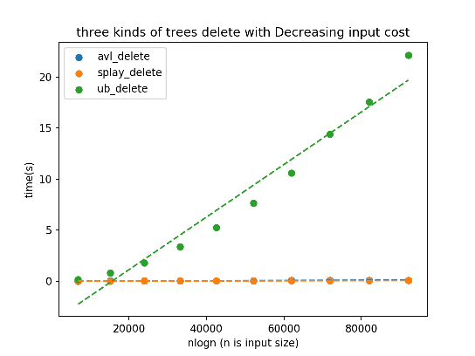
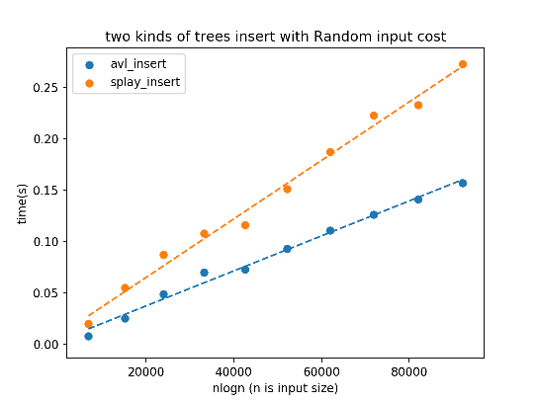
3. Test Results(choose some examples)

Slide 13
4. Analysis and Comments(Time Complexity)
AVL:
the insertion routine for avl tree follow the same process as inserting into a Binary Search Tree. When the node is inserted, avl tree should check whether the node's ancestors are still avl trees. Once the Balance Factor(BF) is changed to 2 or -2, then a single rotation or double rotation will be execute to keep the tree is balanced. The time for lookup is O(log n), and the check of ancestors, which is the way back to the root, cost O(log n) at most. The rotation takes O(1) each time. So the insertion can be completed in O(log n) time.
the delete operation always try to find the max in the left and then subsitute the deleted node with the it. Then check all the ancestors of the max of the left subtree for possible rotation. If there is no left substree, then find the min of the right subtree, the rest same. The find process costs O(logn) and the check with roration costs O(logn), for the height is logn, so the delete operation costs O(logn) time.

Slide 14
4. Analysis and Comments(Time Complexity)
splay tree:
the first step for splay tree insertion is the same as the insertion a normal binary search tree. Then a splay is performed. The new root will be the inserted one, as a result. Since the height of splay tree is uncertain, varying from log(n) to n, (n is the number of nodes), the cost of insertion for splay tree is uncertain. The delete first find the node that to be deleted and do a splay to make it a root. Then find the max of the left subtree of new root(if there exist a left subtree) and splay the left substree to make the max of left the root of the left subtree. Next delete the new root, and make the right subtree be the left subtree's root's right subtree. For the same reason with the insertion, the cost of deletion can not be determined.

Slide 15
4. Analysis and Comments(Time Complexity)
However, a amortized analysis of splay tree can be carried out using the potential method. Define:
S(r) = the number of nodes in the sub-tree rooted at node r (including r).
rank(r) = log2(size(r)).
Φ(T) = Σrank(all nodes) = the sum of the ranks of all the nodes in the tree.
So we first caculate the ΔΦ: the change in the potential caused by a splay operation. There is three case, zig, zig-zag, zig-zig. We discuss them seperately. Denote by rank′ the rank function after the operation. x(the splayed node0, p(the parent of x) and g(the parent of p) are the nodes affected by the rotation operation.

Slide 16
4. Analysis and Comments(Time Complexity)
Zig:
ΔΦ = rank′(p) − rank(p) + rank′(x) − rank(x) [since only p and x change ranks]
= rank′(p) − rank(x) [since rank′(x)=rank(p)]
≤ rank′(x) − rank(x) [since rank′(p)<rank′(x)]
Zig-Zig step:
ΔΦ = rank′(g) − rank(g) + rank′(p) − rank(p) + rank′(x) − rank(x)
= rank′(g) + rank′(p) − rank(p) − rank(x) [since rank′(x)=rank(g)]
≤ rank′(g) + rank′(x) − 2 rank(x) [since rank(x)<rank(p) and rank′(x)>rank′(p)]
≤ 3(rank′(x)−rank(x)) − 2 [due to the concavity of the log function]
Zig-Zag step:
ΔΦ = rank′(g) − rank(g) + rank′(p) − rank(p) + rank′(x) − rank(x)
≤ rank′(g) + rank′(p) − 2 rank(x) [since rank′(x)=rank(g) and rank(x)<rank(p)]
≤ 2(rank′(x)−rank(x)) − 2 [due to the concavity of the log function]

Slide 17
4. Analysis and Comments(Time Complexity)
The amortized cost of any operation is ΔΦ plus the actual cost. The actual cost of any zig-zig or zig-zag operation is no bigger than 2 since there are almost two rotations to make. amortized-cost=cost+ΔΦ<=3(rank'(x)-rank'(x))
When add all the x together, we got that amortized-cost=cost+ΔΦ=3(rank(root)-rank(x)), which is log(n).
so the amortized-cost for a splay that bring a node to the root is O(logn). thus the amortized-cost for insertion and deletion
unbalanced tree:
the insertion for unbalanced tree is to find the proper position. Every time go left if smaller than the node or go right otherwise. Depending on the input, the operation costs O(log(n)) to O(n). The worst case is that the input is increasing or decreasing. The best case is that the input always keep the tree to be a balanced tree.
the delete is similar to the insertion, cost from O(log(n)) to O(n).

Slide 18
4. Analysis and Comments(Space Complexity)
space complexities:
avl tree:
each node cost O(1) space, so n nodes cost O(n) space. The recursion in insertion or deletion cost at most O(logn) for the height of avl tree is O(logn). So the space complexity is O(n).
splay tree:
each node cost O(1) space, so n nodes cost O(n) space. The recursion cost at insertion or deletion most O(n) for the height of splay tree is O(n). So the space complexity is O(n).
unbalanced tree:
each node cost O(1) space, so n nodes cost O(n) space. The recursion cost at deletion most O(n) for the height of ubalanced tree is O(n). So the space complexity is O(n).

Slide 19
4. Analysis and Comments(Comments)
from the tests results we can see that in random order the unbalanced tree performs best, for it doesn't have any balanced operations and can still be relatively balanced for the input is random. However, when the input is increasing and decreasing the splay tree and avl tree works fine, having little difference with the performance when the input is random, while the performance of unbalanced is terrible. From the test result we can draw a conclusion that generally the ubalanced tree works fine for random input while avl tree and splay tree have excellent performance guarantees for different kinds of inputs.

Slide 20
Thank you.

